Slide 1
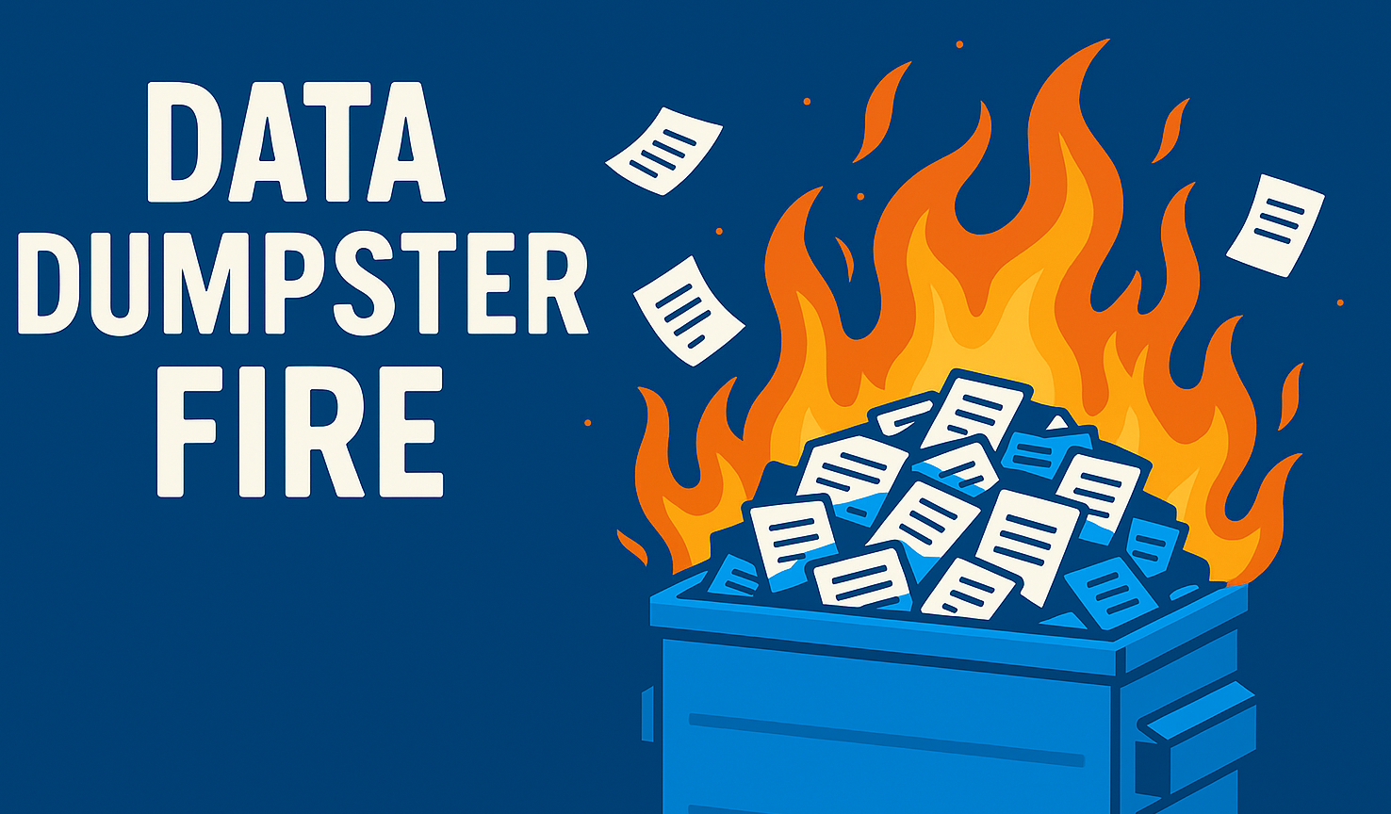

AVOID THE
Practical Planning
For Power Platform Builders
Presented by
Alexis Bell & Amanda Jamison

Slide 2


Meet Your Speakers
Alexis Bell | Linkedin.com/in/alexisjbell
Amanda Jamison | Linkedin.com/in/arjamo
Loves:
Her miniature dachshund Luna
Espresso martinis
RomComs
Organizing data
Also loves:
Her miniature schnauzer Cricket
Malted Mocha from
Caribou
Hiking National Parks
Automating everything

Slide 3

ESOP with HQ in Minneapolis
35 years in business
85% customer retention
200+ employees
        Consultant retention > 90%
  Consultants average 17+ years
  of industry experience
We produce business and customer focused digital products that drive enduring value.​

Slide 4
Custom Software Development
  Cloud Solutions
  Artificial Intelligence + Machine Learning
  Low-Code Solutions
  Data Engineering
Project Planning + Execution
Experience Strategy + Design
Quality Assurance
DevOps
Product Strategy + Coaching
Strategic Partnerships with Microsoft and AWS
What we do
We produce business and customer focused digital products that drive enduring value.​

Slide 5






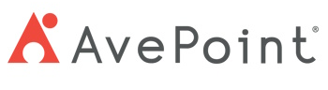


Please thank our sponsors

Slide 6

What to Expect Today
Why Planning Matters
Naming Conventions
Tools and Best Practices
Documentation and Governance
Take home Frameworks

Slide 7

Not a Hands-on Demo
Your Data Will Change
Pivoting is okay

Slide 8



Why Nobody Talks About This

Slide 9

Invisible Decisions
How did you name that field?
Where’s your single source of truth?
Why does this app need three Status fields?
Why was it named like that?

Slide 10

Planning First is now a Non-Negotiable
DFI = (P₂D + N₄S) ÷ TPS/hr
Dumpster Fire Intensity
Pressure to Deliver
Need for Speed
Total Planning Spent

Slide 11
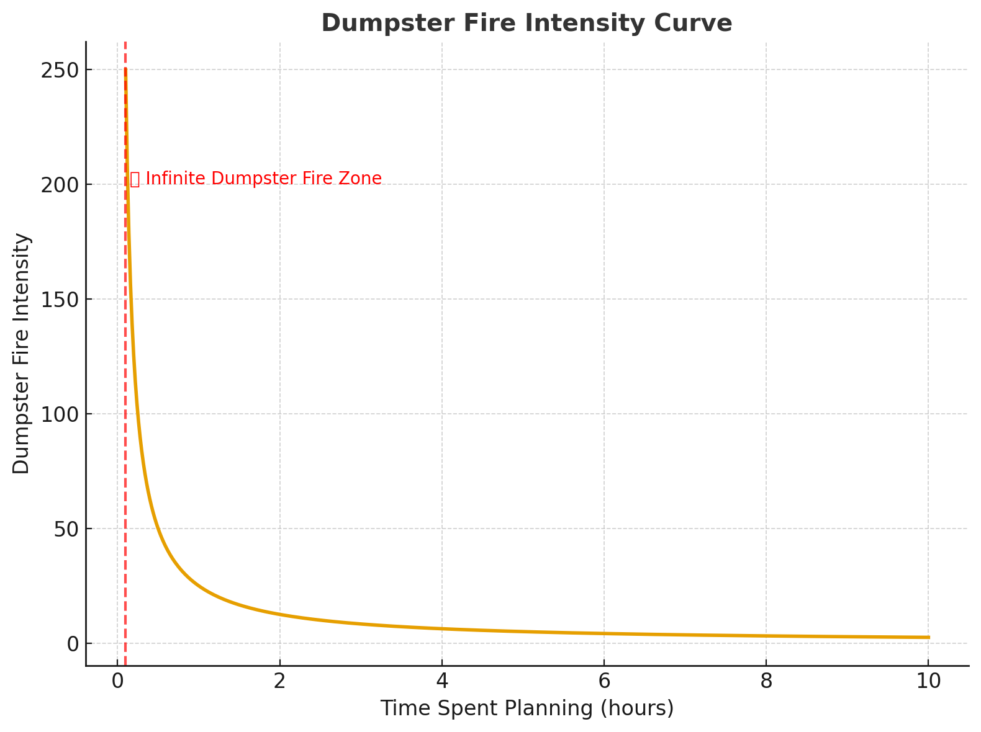
Planning First is now a Non-Negotiable

Slide 12


Without Planning
With Planning
Status Soup
One Status to Rule them All 💍
Think redundant or misused fields
A single field with an agreed upon purpose
Automation failures
Automation flows
Dominos of chaos across solutions and environments
Flow that work together harmoniously
Schrödinger’s Data 🐱
Data Zen Garden
Data is simultaneously important and completely undocumented anywhere.
Data is clean, trustworthy and documented
Mystery Spaghetti
Better Builds and Connections
Confusion over what’s connected to what
Systems connect like concrete

Slide 13

Naming Convention Survival Guide
Essential Guidelines for Power Platform builders to create maintainable, scalable solution that won’t break or confuse future developers.

Slide 14
Why Naming Conventions Are Critical
Inconsistent naming creates cascading problems:
Broken Flows
  Automation fails when field references don’t match.
Wrong Field Usage
  Users select incorrect fields, corrupting data integrity.
Reporting Nightmares
  Analytics break when field names change or conflict.
Formula Breakage
  Calculations fail when references are renamed.
Relationship/Lookup Mess
  Lookups and connections fail across data sources.

Slide 15
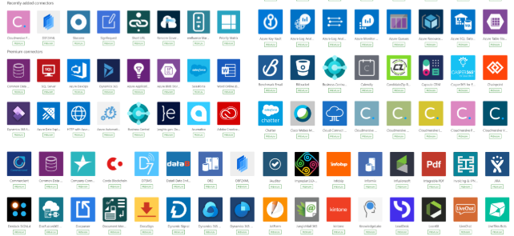



















Multiple Data Sources Amplify the Problem
There are currently over
1400
available connectors!
Modern Power Platform solutions integrate multiple systems, making consistent naming essential for seamless data flow and maintenance.

Slide 16
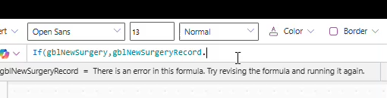
Field & Table Naming Best Practices
NO SPACES ANYWHERE
Avoid spaces in table names and field names entirely. Spaces break references and cause integration issues.

Slide 17
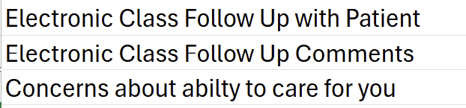
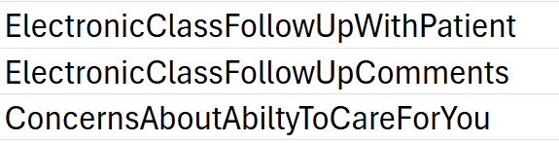

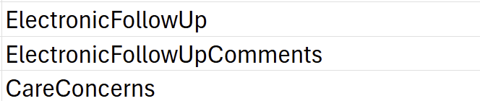
Field & Table Naming Best Practices
Be Specific But Concise
Use descriptive names that clearly indicate purpose without being unnecessarily lengthy.

Slide 18
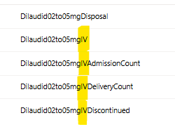
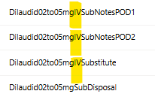
Field & Table Naming Best Practices
Stay Consistent
If using ‘PatientName’ in one location, use it everywhere. Don’t mix ‘Name’, ‘Patient’s Name’, or ‘Patient’.

Slide 19

Field & Table Naming Best Practices
Follow Case Conventions
camelCase: App controls (btnSubmit)
PascalCase: Database fields, apps, workflows
Underscore Only
Use underscores as the only special character – they behave like letters in most systems.
Limit Abbreviations
Write out terms in field labels, even if team members ‘should’ know the abbreviations.

Slide 20
App Component Naming Standards
Screens
Use underscores for screen compatibility
Examples: 'Home'; 'Dashboard', 'Patient_Information'
Controls
Control type prefix with descriptive identifiers
Examples: txtFirstName, lblFirstName, btnSubmit
Screen Specific Controls
Add screen initials for controls appearing on multiple screens
Examples: btnSubmit_H; btnSubmit_D; btnSubmit_PI
Variables
Global are used throughout the app and local are used within the same screen
Examples: gblUser, gblDesign and locShowPopUp, locClosePopUp

Slide 21

Essential Guidelines
Use Prefixes & Suffixes
Add company or project identifiers when working across multiple teams and environments. This prevents confusion with database, app and environments names.
Example:
ProjectA_Customer_Portal
ProjectB_Customer_Portal
Maintain Living Documentation
Track naming standards in shared documentation.
Keep it updated and accessible to all team members.
Example: OneNote or our Data Reference Guide Template

Slide 22

You’re Saving Your Future Self
Consistent naming conventions prevent headaches for future developers – including yourself when you revisit projects months later. Clear and predictable names make troubleshooting and enhancements exponentially easier.

Slide 23
Know Your Tools, Know Your Data
We build in a tangled ecosystem where every tool treats data differently

Slide 24





Best Practices for Data Modeling
Normalize your data across systems always
Find your documentation a home
Use Look ups with intention
Define a
Source of Truth

Slide 25
Practical Governance Tips
Start with data analysis before you build!
Determine ownership
What is the source of truth
Is there a retention policy?
Document as you go

Slide 26

Data Reference GuideTM
A data reference guide is a centralized reference that defines your tables, fields, and relationships; what they mean, how they’re used, and where they appear across your solution.
How to get started:
Involve the stakeholder early
Use consistent naming conventions
Use plain language

Slide 27
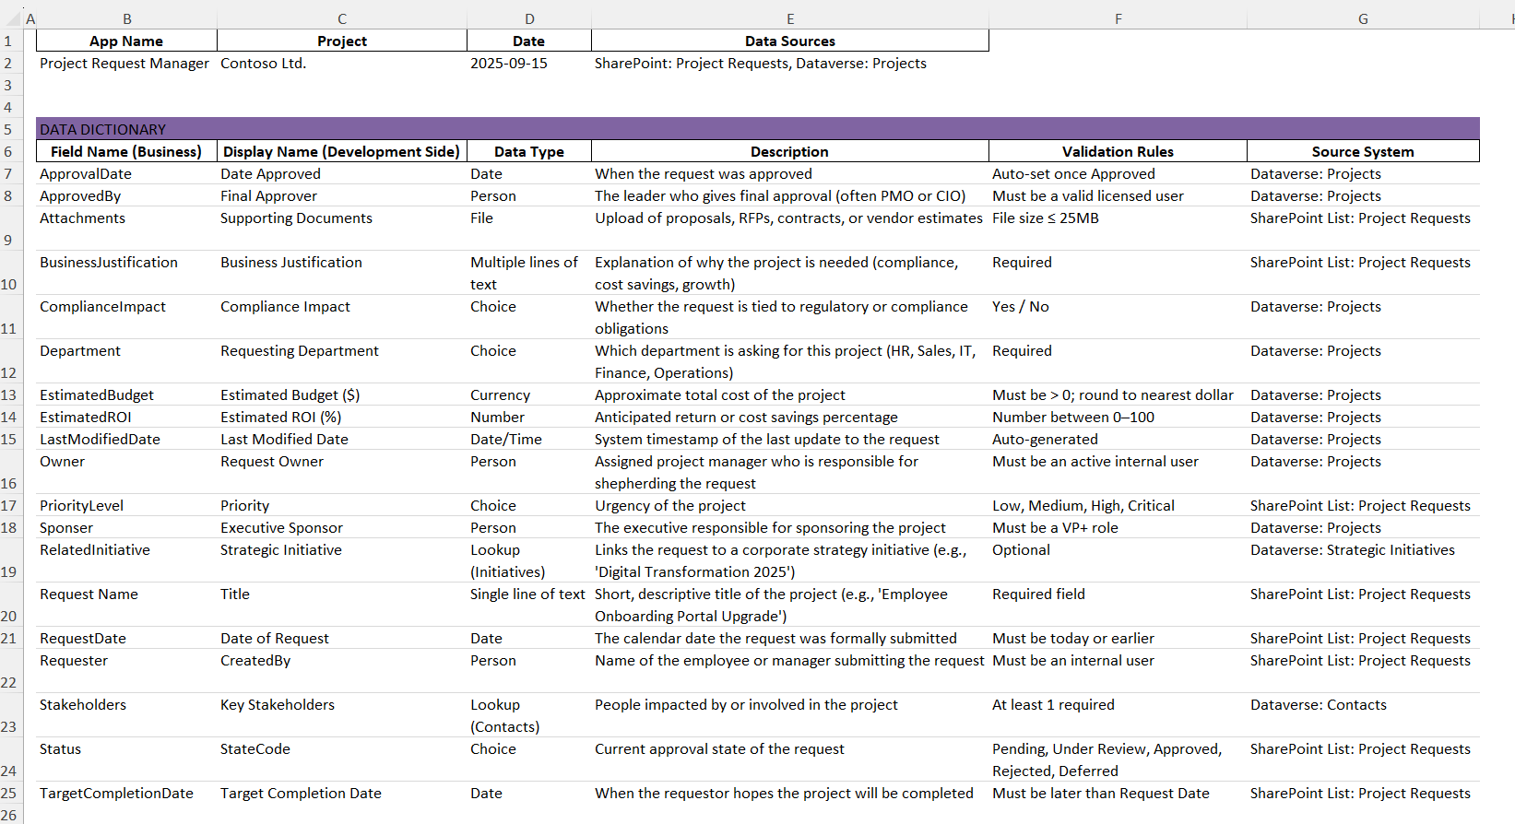
Data Dictionary

Slide 28
Data Reference Guide in Action
Formerly known as:
“That Spreadsheet Alexis Made That We Now All Depend On For Every Project Ever”
Naming conventions & flow patterns
Make it a team artifact!
Data_Reference_Guide_Template.xlsx

Slide 29

Workflow Documentation
Helps you six months later when nothing looks familiar
Recommended Workflow Logging Sections:
  Workflow Overview
    Table of Flows and Purpose
    Entity Relationships
    Version History
  Flow Inventory
  Known Issues / Future Enhancements
  Field Definitions – use your data reference guide!
📎Use comments and Notes in Power Automate steps and control naming in Power Apps to support inline documentation.

Slide 30
Dumpster Fire: A Real Case Study
What went wrong
How we recovered
Lessons learned

Slide 31

Closing Takeaways
Planning is a shortcut, not a blocker
Every platform handles data differently
Good naming = future sanity
DON’T USE SPACES
Your data model is your foundation
Governance can start small
Future you deserves better

Slide 32
STORY TIME
What’s your story?
Quick wins to take home

Slide 33

Our Favorite Resources
Data
Power Apps Coding Standards for Canvas App – Matthew Devaney
Training
Microsoft Power Up Program
Microsoft Learning & Certifications:
Power Platform Fundamentals (Beginner)
Power Platform Functional Consultant Associate (Intermediate)
Power Platform Developer Associate (Intermediate)
Power Platform Solution Architect Expert (Advanced)
Other Great Links
Microsoft Power Platform Release Plans
MN M365 User Group
  MN M365 User Group YouTube
M365 Twin Cities
  Past Session Downloads

Slide 34
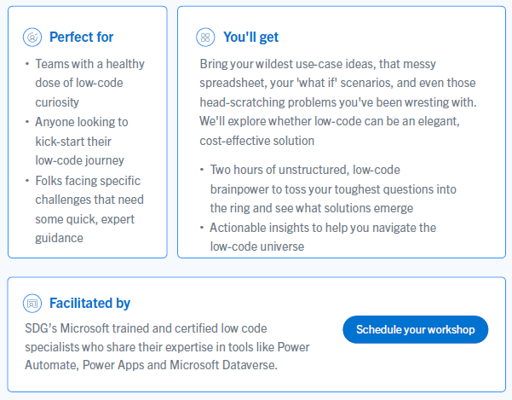

SDG Low Code Solutions
2 Hour
Workshop
Could Low Code be the right solution for your business?

Slide 35


Submit session feedback

